Slide 1
Current: $18.57 Target: $21.76 (+18%) Time Horizon: 12-18 Months
Vertiv Holdings Co. (NYSE: VRT)
Industry Director: Michael Betancur
Analysts: Bricen Fisher, Nirmal Malhotra, Ray Hatton
Junior Analyst: James Kearney

Slide 2
Company Overview
Business Description
Geographic Breakdown
VRT provides and manufactures:
Technological infrastructure to house data centers, communication networks in commercial and industrial environments
Services to help clients capitalize on their products efficiency (270+ service centers)
The company was founded in 1965 and headquarter in Columbus, Ohio
Total revenue is ~$4.8B with customers in 130+ countries and 19 global manufacturing locations
Business Highlights
Revenue Breakdown
A deal initiated on December 10th, 2019 to acquire GS Acquisition Holdings (NYSE: GSAH)
On September 21st, 2020 Vertiv is added to both the S&P Global BMI Index and S&P TMI Index
On October 14th, 2020 Honeywell and Vertiv integrated solutions to optimize data center sustainability, resiliency, and operational performance
As of 2020, they’ve grown to partner with industry leaders such as: Alibaba, Equinix, Tencent, AT&T, China Mobile, Microsoft, Facebook, & Verizon
Top 50 Customers represent ~35% of Revenue
Sources: Capital IQ, Company Website, Company Financials

Slide 3
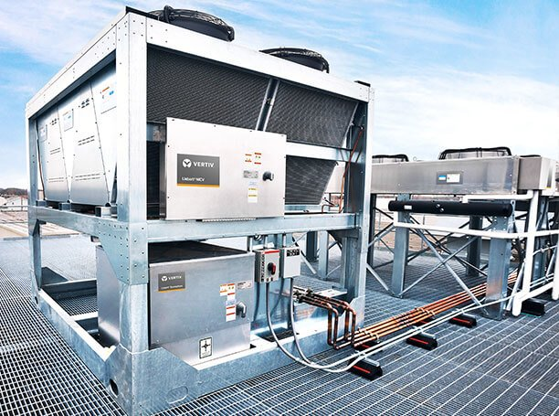
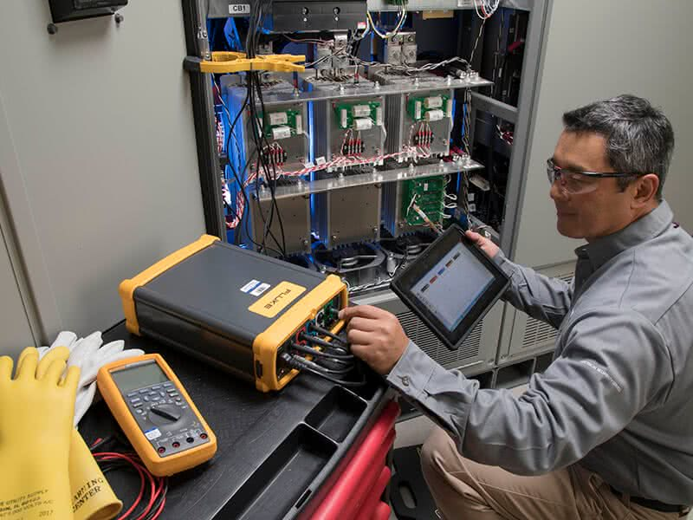
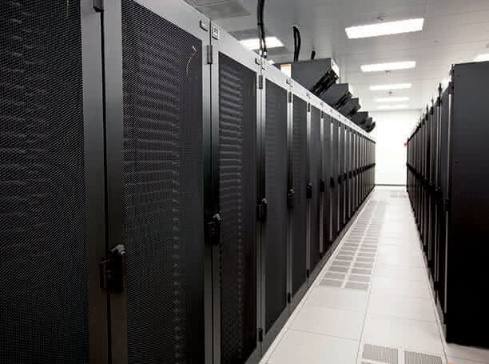
Business Segment Overview
Critical Infrastructure
Services
Integrated Racks
Thermal Management
Efficient and reliable heat management & control solutions
Vertiv Holds 32% of market share
8 products in thermal management
Critical Power
Power solutions are a fundamental part of the data center market with Veritiv holding 16% of market share
5 major products in power solutions
Monitoring and Management
Effective management of systems through software, AI, and controls through 6 major products
Services & Maintenance
On-site project management, energy consumption monitoring, maintenance, and coverage
Vertiv holds 12% of market share
7 services
Project Based
UPS & Battery
Thermal Management
Rack PDU
DC Power
Electrical Reliability
Electrical Safety & Compliance
Racks & Enclosures
Modular data center solutions allow Vertiv clients to fit space and budget needs efficiently
Data centers typically update their IT equipment every 3-5 years giving Vertiv a stable source of demand
Cloud computing saw exponential growth in the early 2000’s (2006) meaning data centers will need major updates in 2021-2023
Veritiv's 3 major products include
Integrated solutions
Racks and containment
Outdoor enclosures
Sources: Capital IQ, Company Website, Company Financials, insight.com

Slide 4
Financial Overview
52 Week Price Change
Enterprise Value Walkthrough
1
3
$ in Millions
Share Price | $18.34
Shares Outstanding | 328.4
Equity Value | 6,022.9
Cash & Short-Term Investments | 369.7
Total Debt | 2573.7
Preferred Equity | NA
Minority Interest | NA
Enterprise Value | 8,226.9
2
$18.57
As of Oct-21
Financial Highlights
Key Metrics
COVID-19 fears heighten
10-year Treasury yield hits 1.3%. WHO (World Health Organization) on March 11th designated outbreak as a global pandemic
Stock market rebound
Stimulus from the government and the FED cutting interest rates
August 5, 2020 Vertiv releases positive Q2 earnings
Orders are up 2% and 5% from new client demand and returning client demand respectively
This increase in demand drove the price up ~37%
1
Market Cap | $6.02 Bn
52 Week Range | $4.75 - $18.64
EV/EBITDA | 17.20x
LTM Gross Profit Margin | 33.10%
LTM P/E | 16.14x
Beta | 1.01
2
3
4

Slide 5
Industry Overview
Hyperscale Data Centers: massive data facilities
41 hyperscale data centers have opened since October 2019 and 176 more are in planning for the next year
Colocation Services: Equipment, space and bandwidth are rented from Vertiv to customers
Grew 4.5% from 2015-2020, currently sits at $15 billion in total market size
Drivers: Increased online businesses, demand for data processing and hosting services, rising cost of electric power pushes customers into colocations
Data Centers
Colocation Revenue 2019-2023 ($Bn)
CAGR 2.73%
Communications
Broadband connections 2019-2023 (Mm)
Applications: Streaming, Social networking, Consumer apps, Business apps, Databases, Computing, Digital security, E-Commerce
Broadband is used for high-speed transmission in telecommunications
On average users downloaded 5.8 GB each month per subscription in 2019 compared to 4.7GB in 2018
19M Americans (6% of the population) lack access to fixed broadband services at threshold speeds. 5G provides a solution to this
CAGR 4.78%
Sources: MarketsandMarkets, IBIS World, Cisco.com, 451 Research

Slide 6
Industry Drivers
5G Infrastructure Market Growth
Global 5G Infrastructure Market Size (Bn)
5G expansion across products such as cell phones, autonomous vehicles, data analysis, and smart homes for total market growth
The 5G tech market has a CAGR of 70.83% valued at +$700 billion by the end of 2025
Telecommunications giants around the globe are increasing spending on 5G Infrastructure
Vertiv hardware is a critical part needed for IT and data center infrastructure
CAGR 106.4%
Cloud Infrastructure Market Growth
Cloud Infrastructure Market Size (Bn)
Cloud spending rose 37% to $29 billion in the first quarter of 2020 alone, this trend is expected to continue to +$100 billion by 2021
Hybrid cloud adoption is 58% with the use of different cloud services with over 90% of companies being on the cloud
Amazon is the largest cloud service provider globally with a 33% market share with over 116 data centers globally serviced
Increase in cloud use significantly increases demand for cloud infrastructure
CAGR 18%
Sources: Grand View Research, MarketsandMarkets, PWC , 451 research, RightScale

Slide 7
Investment Rationale
Prefabricated modular data center market growth leads to growth in revenues
PFM data centers are constructed 30% faster than average data centers, taking 4-6 months to deploy.
PFM data centers are set to expand at a CAGR of 14.4% through 2021 to increase revenues
Efficiency rates of +96% & reduced footprint, saving +$125,000 of operational cost on power alone
Modular data centers save initial build cost by 20-30% compared to their stick build counterparts. Demand will increase for PFM’s as bandwidth grows
Modular Data Center Market (B)
Data center management & maintenance creates recurring revenue for Vertiv
40% of companies have accelerated their move to the cloud reflecting a need of critical infrastructure
2.45 quintillion bytes produced everyday expected to increase 18,798% to 463 quintillion bytes in 2025
Offering services such as thermal management services increases recurring revenues adding to their record backlog of 1.8 billion
Maintenance and service revenues continued growth through customer acquisition creates sticky revenue
Recurring Income (%)
Sources: Grand View Research, Investor Presentation, CISON, Capacity, Industry Today

Slide 8
Investment Rationale
Digitization of industries increasing necessity of critical infrastructure
67% of large corporations said they’re implementing a work from home strategy indefinitely implying a 44% growth since 2015
Data centers become a critical necessity as companies switch to cloud storage & save an average of 37% from switching to cloud data
Industries planning to increase spending on the cloud: Manufacturing $19.7 billion, professional services $18.1 billion, and banking $16.7 billion
Cloud Market Share 2020
Globalization of 5g services will lead to electronic infrastructure overhauls
The 5G market is expected to have incremental growth in the coming years with 1.9 billion mobile users to be using 5G data by 2024
Leaders of the industry Verizon & AT&T spent $7.7 billion this year on spectrum for 5G indicating widespread support of the development of 5G
Governments of the largest countries such as China, India, & The US are pushing for 5G development use with 5G expected to add $3 trillion in global GDP by 2035
Not Clients
Vertiv Clients
Global 5G Service Market Size (Bn)
Sources: Qualcomm, VRT Website, Mordor Intelligence, Statista, IDC, Telecomlead, FCC

Slide 9



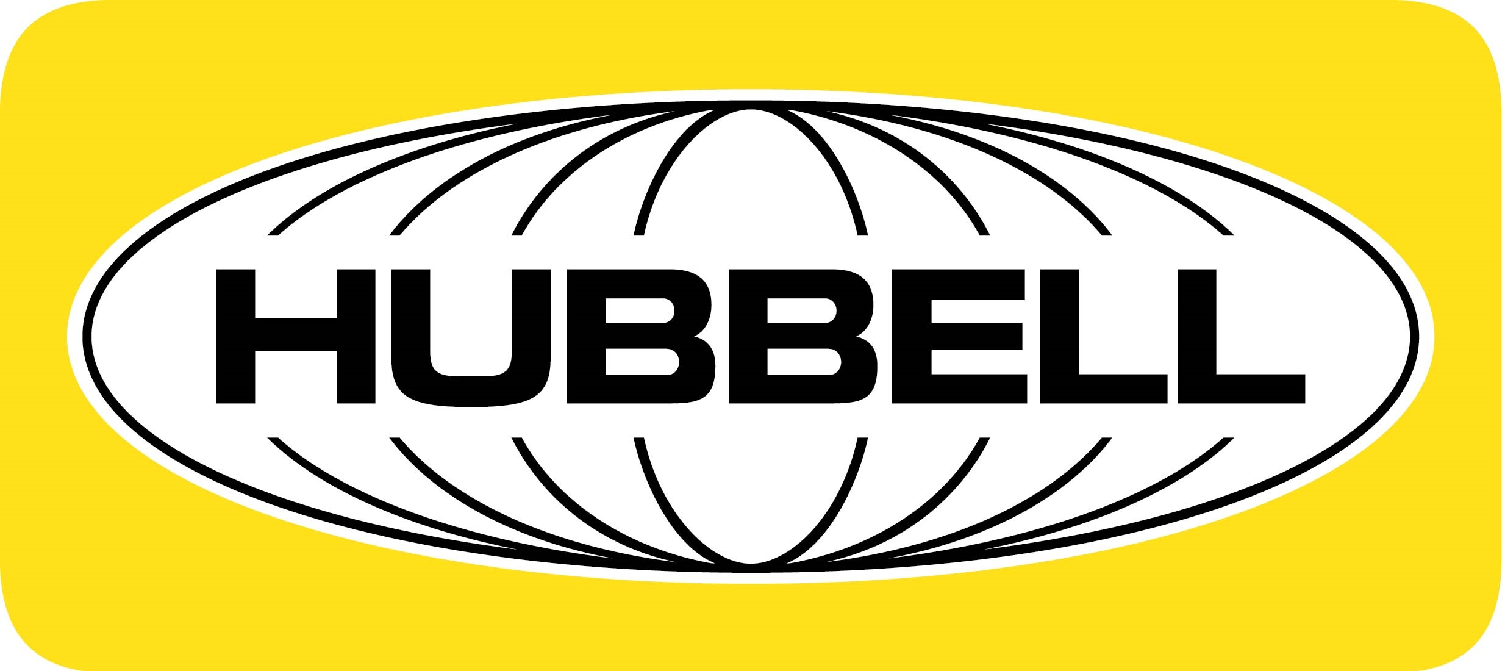









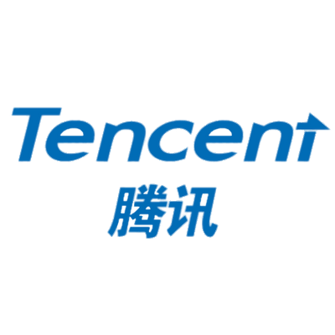






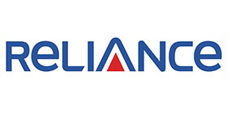




Competitive Advantage
Leading Global Player
Data Centers
Communications
Industrial
Power, Thermal, Service
Revenue Growth¹ | 3.3% | (0.9)% | 3.1% | 2.9% | 1.1%
EBITDA Growth¹ | 8.8% | 1.9% | 2.4% | 3.9% | 1.7%
End-markets Served
Global Clients
Average tenure:
~15 years
Power Management
Thermal
Management
Data Center
Converged
Average tenure:
~25 years
IT Infrastructure
Services
Solutions
Communication
Average tenure:
~15 years
Vertiv
Schneider
Legrand
Eaton
Stulz
Other
Sources: Seeking Alpha, Investor Presentation
CAGR from 2018A – 2020E

Slide 10



Competitive Landscape
Mkt Cap | 60,135
N.I. Margin | -5.1%
Quick Ratio | 1.6x
Mkt Cap | 7,827
N.I. Margin | 9.1%
Quick Ratio | 1.3x
Mkt Cap | 41,580
N.I. Margin | 11.4%
Quick Ratio | 0.9x
Operates as a high-tech industrial conglomerate through Power, Renewable Energy, Aviation, & Healthcare segments
GE decided to develop their software market with GE Digital with less focus on hardware. After significant investment GE Digital failed to generate substantial revenue
GE Digitals own cloud-based equipment management software platform, Predix, has faced delays and technical issues compared to Veritiv's equipment management software platforms
Designs, manufactures, and sells electrical and electronic products in the United States and internationally
Hubbell competes most closely with Vertiv selling commercial infrastructure for data centers and colocation facilities
Hubbell has difficulties adapting to the changing environment of electrical products for data centers with electrical revenue declining $35 million YoY, whereas Vertiv has continued to adapt to consumer markets
Provides solutions to industrial, commercial, & consumer markets. Operates through Automation Solutions and Commercial & Residential Solutions segments
Produces system protectors, flow control devices, monitoring equipment & electronic controls competing with Veritiv's Thermal Management and Monitoring services
Expected earnings for midpoint 2020 is $3.10 yet midpoint earnings fell as only $1.56 as project delays and declining energy prices led to weak earnings
Sources: Capital IQ, Investor Presentations

Slide 11
Public Comparables
Sources: Capital IQ, Investor Presentations

Slide 12
Precedent Transactions
Sources: Capital IQ, Investor Presentations

Slide 13
DCF
Sources: Capital IQ, Investor Presentations

Slide 14
DCF Output
Sources: Capital IQ, Investor Presentations

Slide 15
Football Field Analysis
Legend
52 Week Range |  | Current Trading Price
Sources: Capital IQ, Investor Presentations

Slide 16
Potential Risks
Vertiv has a limited history of operating as an independent company
Mitigant: Vertiv’s recent introduction to the market may lead investors to believe that sales and growth rates are not yet stable, but Vertiv has had a stable foundation in Emerson Electric Co prior to its introduction to the public market and a record backlog to sustain growth
Less favorable contractual terms awarded to larger volume customers
Mitigant: Larger customers with over 100 data-centers worldwide such as AT&T, Equinix, and Verizon, are afforded more favorable terms due to the large scale of the contracts. This is a net positive due to the large revenues that they create
Failure to mitigate long-term fixed-price government contract risks
Mitigant: Government contracts contribute to Vertiv’s record backlog but are subject to the changing conditions of government. American infrastructure remains a bipartisan issue and Vertiv has continued to strengthen its relationship with the government through its new product offerings that are ideal for government facilities, such as secure Cybex Multiviewers
Results of operations, financial position, cash flows, & liquidity may continue to be negatively affected by COVID-19.
Mitigant: Transportation delays, travel restrictions, and closures of facilities have led to disruptions in supply chain that have had a negative impact on efficiencies of product delivery. Vertiv has partnered with companies, such as Honeywell, that allow access to established supply chains to ensure the continuous flow of products and support to customers
Sources: Capital IQ, Investor Presentations, Company Website

Slide 17
Q&A

Slide 18
Appendix

Slide 19
Appendix

Slide 20
Appendix

Slide 21
Appendix

